Slide 1

Analysis of Global Technology Trends and IT Job Market
SAGHIR Haitham

Slide 2



OUTLINE
Executive Summary
Introduction
Methodology
Results
Visualization – Charts
Dashboard
Discussion
Findings & Implications
Conclusion
Appendix

Slide 3

EXECUTIVE SUMMARY
Point 1: Conducted a comprehensive analysis of the tech landscape using the Stack Overflow Developer Survey and Job Board APIs.
Point 2: Identified key drivers in current programming language popularity.
Sub Point 1: Python and JavaScript remain dominant for web and data tasks.
Sub Point 2: Emergence of TypeScript and Go as high-growth languages.
Sub Point 3: Shift toward specialized languages in cloud environments.
Point 3: Analyzed database preferences, showing a strong trend toward NoSQL and Cloud-integrated systems (like MongoDB and PostgreSQL).
Point 4: Correlated technology skills with average annual compensation to identify high-value career paths.
Point 5: Developed an interactive dashboard to visualize market demand and supply of developer talent.

Slide 4

INTRODUCTION
Point 1: This project aims to analyze the current state of the global technology landscape using real-world datasets from 2023-2024.
Point 2: The primary goal is to identify which programming languages and databases are dominating the market and which are projected to grow.
Point 3: By leveraging the Stack Overflow Developer Survey, we explored the correlation between specific technical skills and job market compensation.
Point 4: This analysis provides actionable insights for both employers looking for talent and developers looking to upskill in a competitive market.
Sub Point 1: Focused on identifying "High-Demand" vs. "High-Supply" technologies.
Sub Point 2: Examined regional variations in job postings and salary trends to provide a global perspective.

Slide 5

METHODOLOGY
Data Collection: Gathered data using Python libraries to access the Job Posting API and Scrapy/BeautifulSoup for web scraping.
Data Wrangling: Cleaned and pre-processed the Stack Overflow survey results using Pandas to handle missing values and duplicates.
Exploratory Data Analysis (EDA): Performed statistical analysis to identify distribution, outliers, and correlations in the tech stack.
Data Visualization & Dashboarding:
Sub Point 1: Created static charts using Matplotlib/Seaborn for deep-dive reporting.
Sub Point 2: Developed an interactive dashboard in Cognos/Looker Studio for dynamic data exploration.

Slide 6

RESULTS
Results: Visual Insights
This section summarizes the data processed through our analysis pipeline, focusing on market demand and compensation.
Visualization – Charts:
Job posting by Location: Bar charts showing demand distribution, sorted descendingly.
Salary Comparison: Ranking of programming languages based on average annual earnings.
Top 10 Rankings: Identification of the highest-paying technologies for the upcoming year.
Dashboard:
Integrated View: A consolidated dashboard combining job availability and salary trends.
Data-Driven Logic: Transformation of API and scraped data into actionable career insights.
Notes:
Results: Visual Insights
This section summarizes the data processed through our analysis pipeline, focusing on market demand an compensartion.
Visualization – Charts:
Job posting by Location: Bar charts showing demand distribution, sorted descendingly.
Salary Comparison: Ranking of programming languages based on average annual earnings.
Top 10 Rankings: Identification of the highest-paying technologies for the upcoming year.
Dashboard:
Integrated View: A consolidated dashboard combining job availability and salary trends.
Data-Driven Logic: Transformation of API and scraped data into actionable career insights.

Slide 7
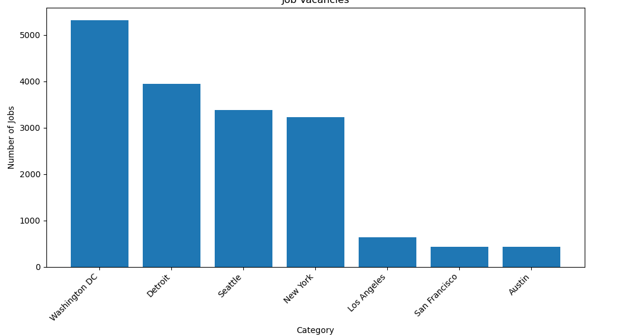
JOB POSTINGS
Data collected via Job API, processed with Pandas, and visualized using Matplotlib.

Slide 8
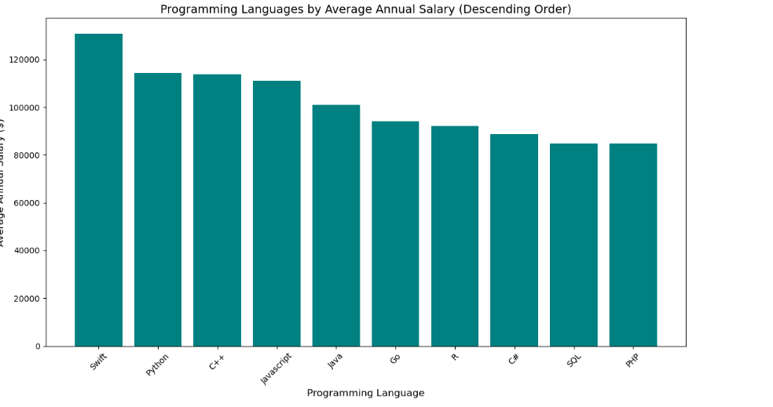
POPULAR LANGUAGES
This chart represents salary data collected through web scraping. The data was cleaned and processed using Python (Pandas/BeautifulSoup) and visualized in descending order to highlight the most lucrative programming languages in the current job market.

Slide 9
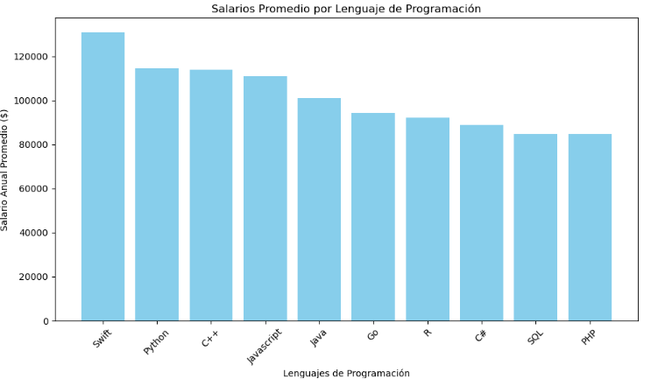
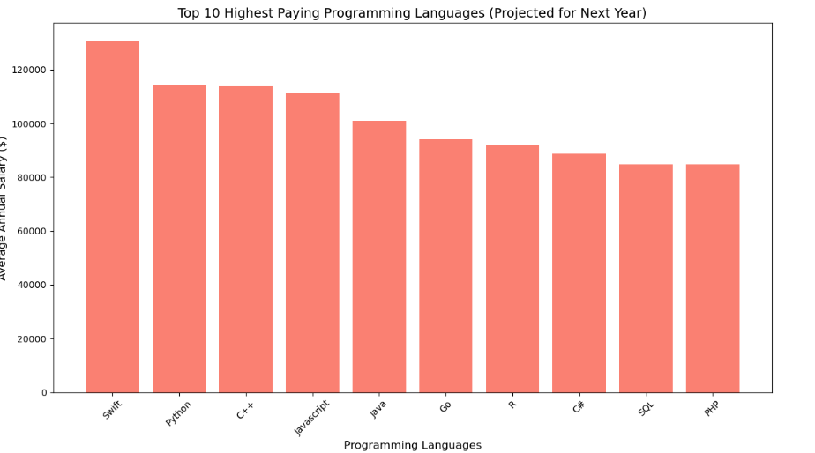
PROGRAMMING LANGUAGE TRENDS
Summarize key trends shown in the charts.
Current Year
Next Year

Slide 10
PROGRAMMING LANGUAGE TRENDS - FINDINGS & IMPLICATIONS
FINDINGS
Salary Leaders: Python and Java consistently rank among the highest-paying languages in the current market.
Geographic Clusters: Job availability is highly concentrated in specific tech hubs like New York and San Francisco.
Database Value: Proficiency in specialized systems like MongoDB and SQL correlates with premium salary scales.
IMPLICATIONS
This chart represents salary data collected through web scraping.
The data was cleaned and processed using Python (Pandas/BeautifulSoup) and visualized in descending order to highlight the most lucrative programming languages in the current job market.

Slide 11
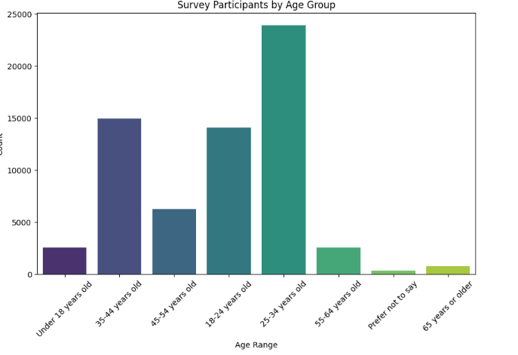
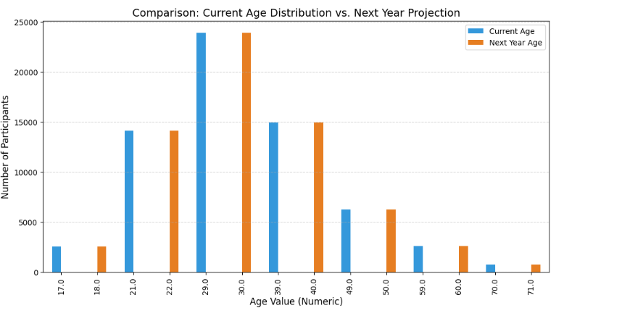
DATABASE TRENDS
Summarize key trends shown in the charts.
Current Year
Next Year

Slide 12
DATABASE TRENDS - FINDINGS & IMPLICATIONS
.
FINDINGS
Finding 1 : Young adult dominance
Finding 2 : Steady annual aging
Finding 3 : Skewed age distribution
IMPLICATIONS
Implication 1 : Target youth marketing
Finding 2 : Long-term retention focus
Finding 3 : Need for user acquisition

Slide 13

DASHBOARD
https://datastudio.google.com/u/0/reporting/3cad7e05-d234-4467-a3d9-f34f0cb4ae28/page/p_3q3qbyrz2d

Slide 14
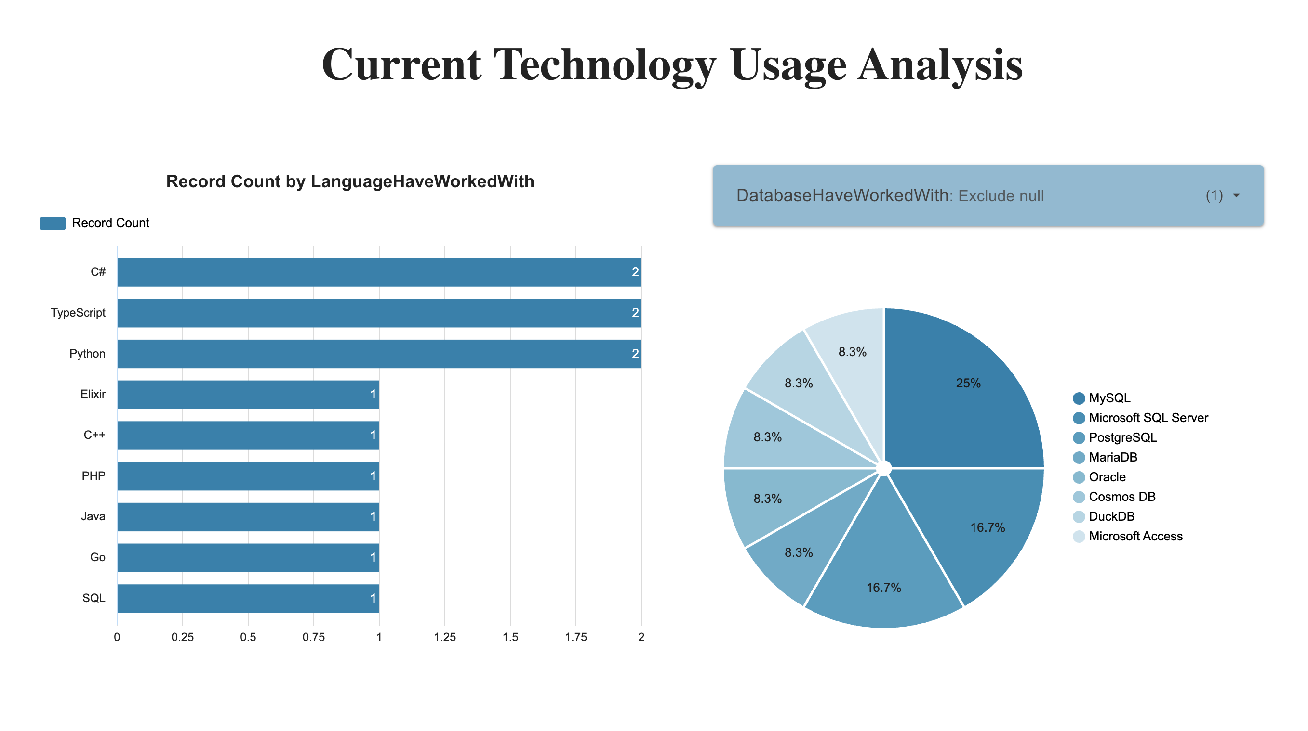
DASHBOARD TAB 1
Dominant Languages: Development is currently led by C#, TypeScript, and Python, which account for the highest volume of active usage in the surveyed group.
Database Market Share: MySQL is the clear leader in data storage, currently holding 25% of the total market share among respondents.

Slide 15
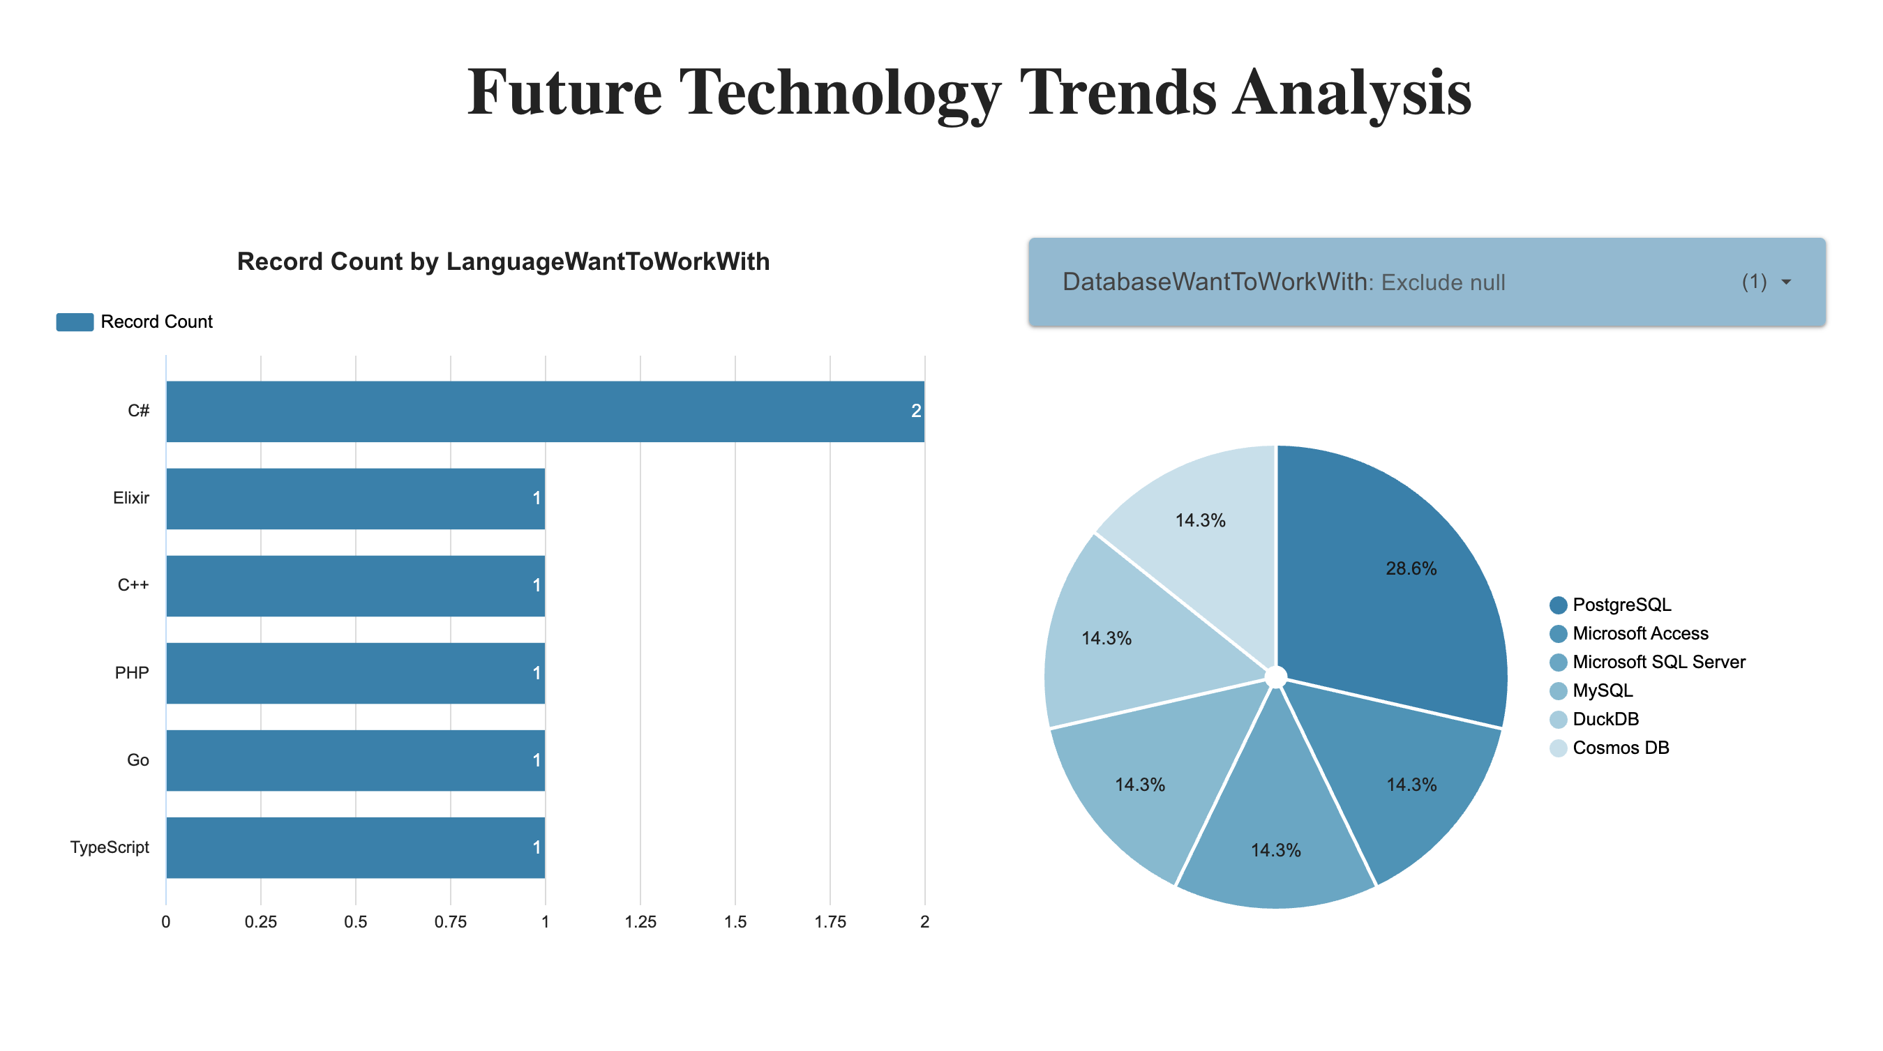
DASHBOARD TAB 2
Future interest aligns closely with current leaders, as C# and Python remain top choices for developers looking to expand their skill sets.
There is a significant projected shift toward PostgreSQL, which captures 28.6% of future interest, indicating it is the most desired database technology for upcoming projects.

Slide 16
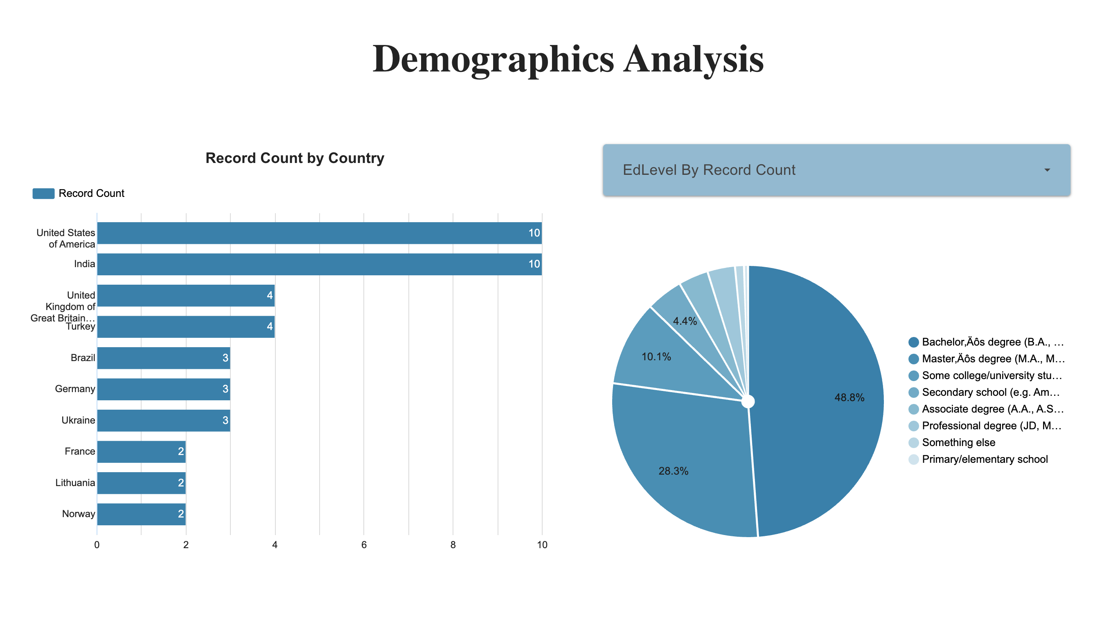
DASHBOARD TAB 3
Employment Trend: Over 81% of respondents are employed full-time, showing a highly active professional workforce.
Educational Background: Nearly half of the participants (46.8%) hold a Bachelor's degree, followed by 25.3% with a Master's degree.

Slide 17
DISCUSSION
The Baseline: Right now, the industry is built on a very solid foundation. Most of the developers we surveyed are sticking with "tried and true" tools like C# and Python, and MySQL is still the go-to for databases. It shows that while new tech gets a lot of hype, these core languages are what actually get work done in most companies.
The Move Toward PostgreSQL: One of the most interesting takeaways is the clear shift toward PostgreSQL in the "Future Trends" section. Even though MySQL leads today, developers are clearly looking for something more robust for their next projects. It feels like the community is gravitating toward it as the modern standard for relational data.
A Professional Workforce: It’s important to note that this isn't just a hobbyist group. Over 80% of the people in this data are full-time professionals, and most have a Bachelor’s or Master’s degree. This means the trends we’re seeing are coming from experienced people who are making technical decisions in their daily jobs.

Slide 18
OVERALL FINDINGS & IMPLICATIONS
FINDINGS
Finding 1 : High Developer Employment Over 80% of the respondents are employed full-time, rather than being students or hobbyists.
Finding 2 : The PostgreSQL Surge While MySQL is currently the most used database, PostgreSQL is the top choice for future development.
Finding 3 : Consistency in Languages Developer interest in core languages like Python and TypeScript remains extremely steady between current use and future desire.
IMPLICATIONS
Implication 1 : The technology trends identified are driven by professional business needs and "enterprise-grade" requirements.
Implication 2 : Organizations should prepare for a migration shift toward PostgreSQL as it becomes the preferred standard for new projects.
Implication 3 : There is no need for a radical "language overhaul" in training; companies should double down on these core skills for long-term stability.

Slide 19

CONCLUSION
Professional Workforce: The survey reflects a mature, highly educated developer community, with over 80% currently employed in full-time roles.
Infrastructure Evolution: While programming languages remain stable, there is a clear and massive shift in interest toward PostgreSQL as the future database standard.
Core Language Loyalty: Python, C#, and TypeScript continue to be the bedrock of development, showing that foundational skills remain the most valuable long-term assets.
Modernization Trend: The industry is moving toward open-source and scalable solutions, indicating that businesses should prioritize upgrading their data infrastructure to stay competitive.

